Slide 1



Slide 2


Give every child a virtual reading coach with Oxford Reading Buddy, a unique new digital reading service that develops deeper comprehension skills and encourages children to read more! What’s more, automatic progression and at-a-glance reporting save you time.
A coach for children and a helping hand to teachers

Slide 3
Contents
Oxford Reading Buddy features Slide 4
Coaching eBooks Slide 5
eBook library Slide 12
Quizzes Slide 15
Automatic placement and progress Slide 18
Performance reporting Slide 22
Rewards and motivation Slide 28
Support site Slide 31
Impact Slide 33
Links to additional support Slide 36

Slide 4

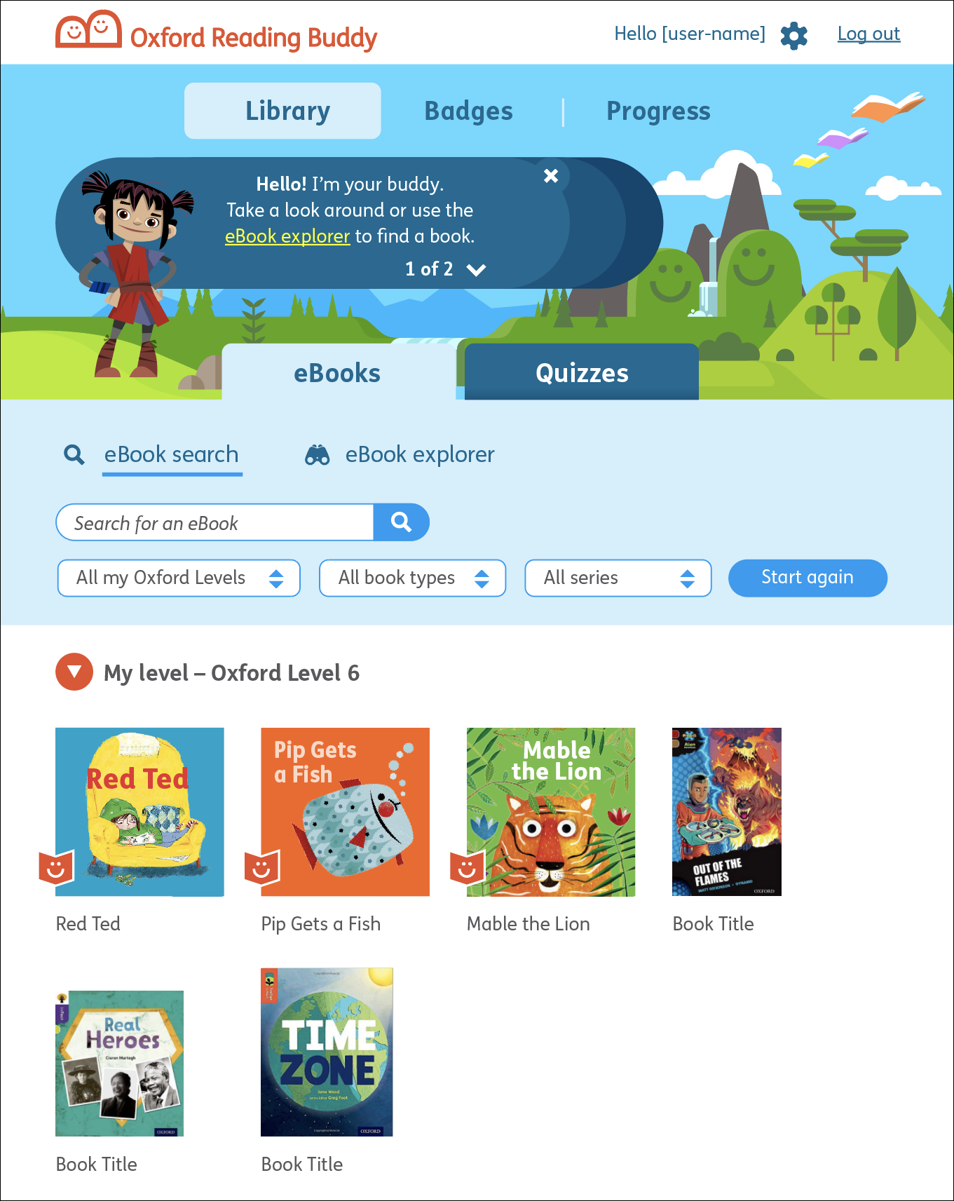
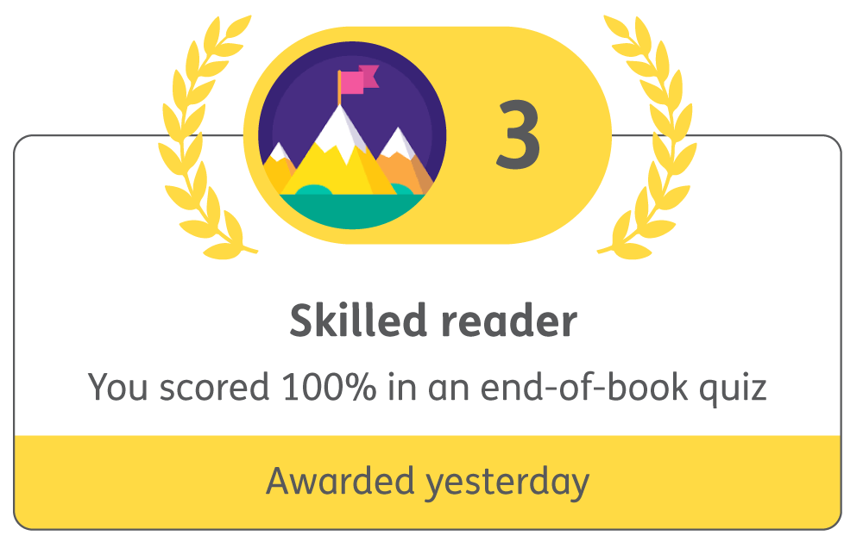
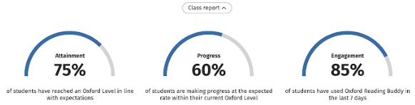
Works on any mobile device!
Oxford Reading Buddy features:
1
2
3
Coaching eBooks...
offer a digital reading ‘buddy’
to coach reading comprehension skills.
eBook library...
for practice and consolidation – all automatically fed to children by Oxford Level.
Quizzes...
across the coaching eBooks, eBook library and printed books. The results prompt progress and performance feedback.
4
5
6
Automatic progression...
through Oxford Levels based on quiz performance so children have constant and immediate access to appropriately levelled books.
Performance reporting...
shows attainment against national expectations, progress and engagement.
Rewards and motivation...
through good books, friendly reading buddies and collectable badges.

Slide 5
1
Coaching eBooks in a nutshell
Coaching eBooks contain a friendly animated buddy who prompts and asks questions to encourage deeper thinking and develop comprehension skills.

Slide 6
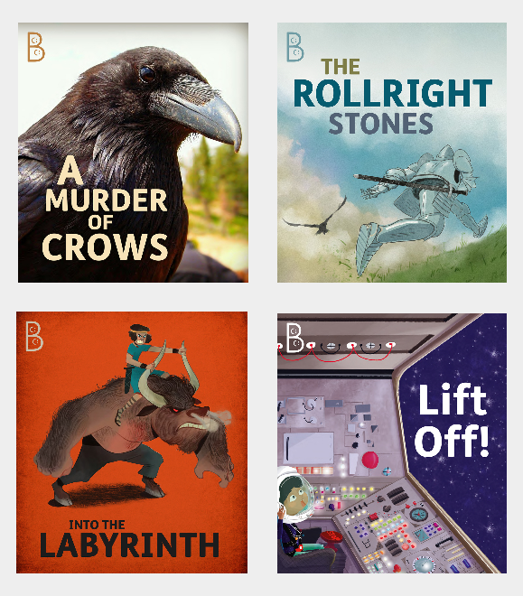
Coaching eBooks: the texts
90 specially written books
Oxford Levels 1-20
Written to develop comprehension strategies and skills
Full range of genres, styles and subjects
Mixed genre texts to provide richest possible comprehension opportunities
1
Coaching eBooks

Slide 7
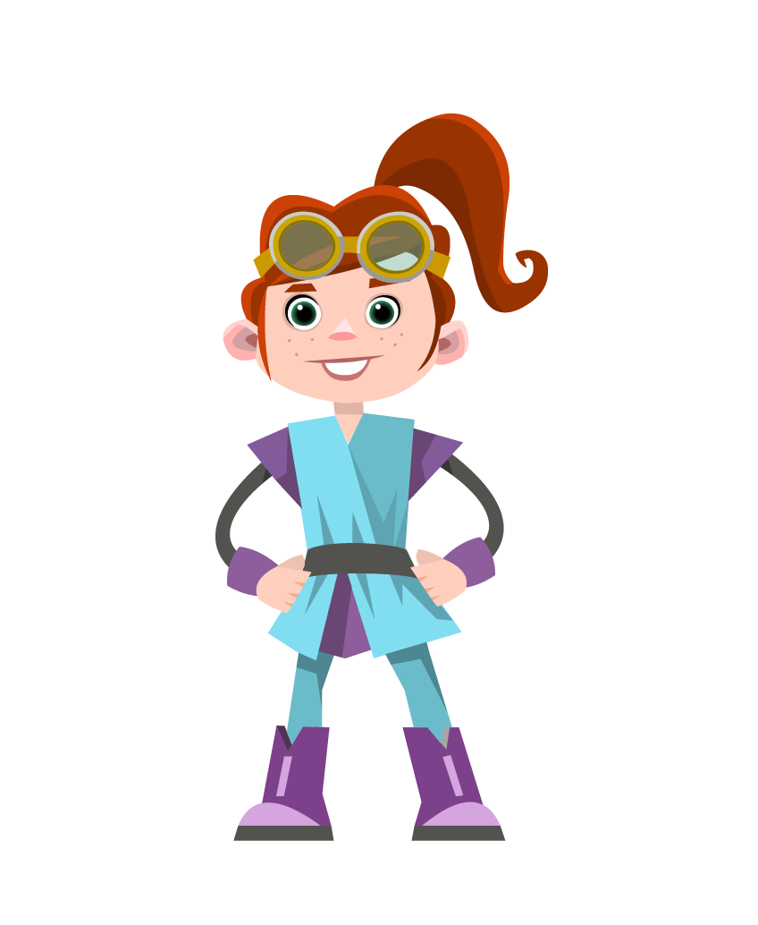
Coaching eBooks: The function
A choice of digital reading ‘friend’ to coach, model and prompt comprehension
An extra pair of hands to turn practice into learning
Prompts based on 7 key comprehension strategies, such as infer, visualize and activate prior knowledge
Buddies improve comprehension and add enjoyment and motivation
1
Coaching eBooks

Slide 8
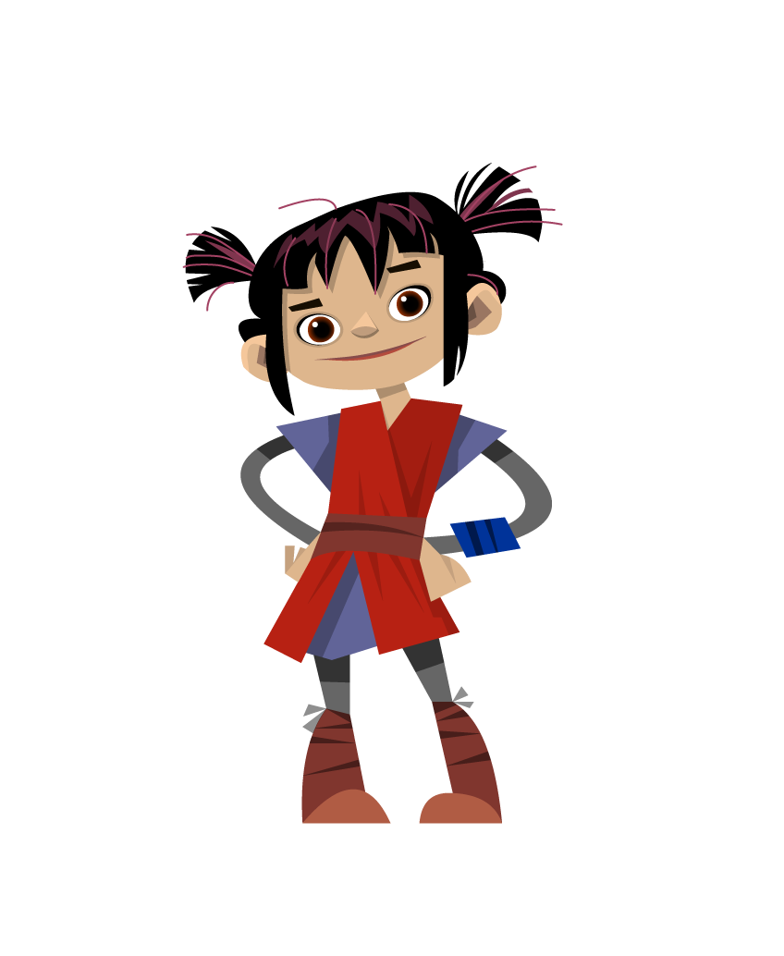
Coaching eBooks: The features
a) Modelling and prompting by making ‘Buddy prompts’, each one linked to a comprehension strategy
b) Supporting and extending by questions within the book: ‘Buddy questions’
c) Assessing through a Quiz at the end of the book
1
Coaching eBooks

Slide 9
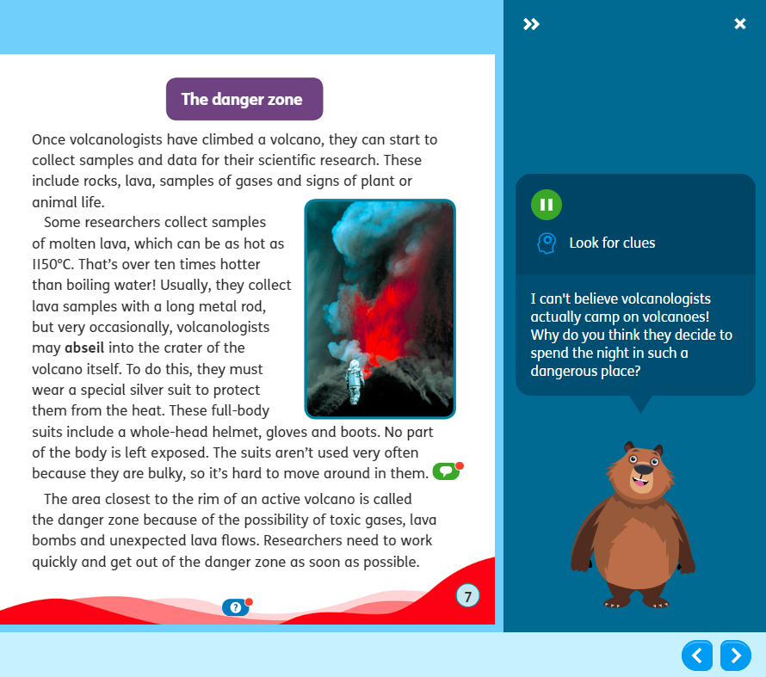
Buddy prompts
Buddy models the thoughts of a good reader
Each prompt is linked to one of 7 key comprehension strategies
Prompts ask open questions to encourage reflection
Gradual internalization of strategies for application in other reading
Students get badges for listening to Buddy prompts and teachers can check engagement in reporting area
.
1
Coaching eBooks

Slide 10
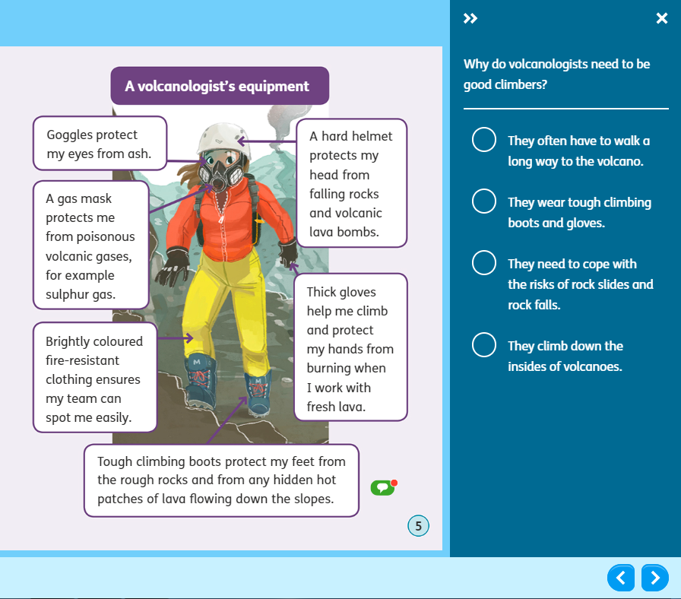
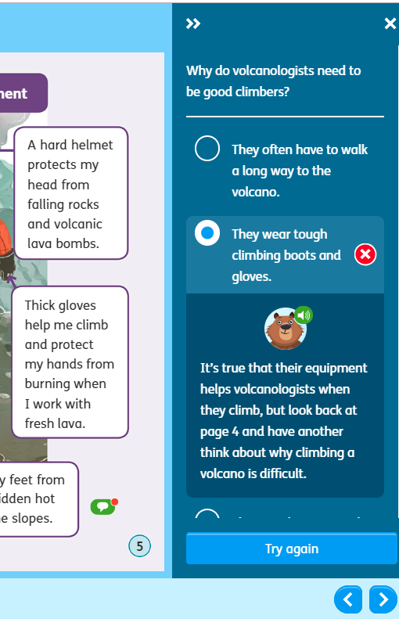
b) Buddy questions
Buddy questions check understanding and support further learning
They give customized feedback to wrong answers and a second chance to answer
Questions often relate to Buddy prompts, so students will do better if they listened to the prompts
Students get badges for good performance and teachers can check engagement in the reporting area
.
Buddy question
Buddy feedback

Slide 11
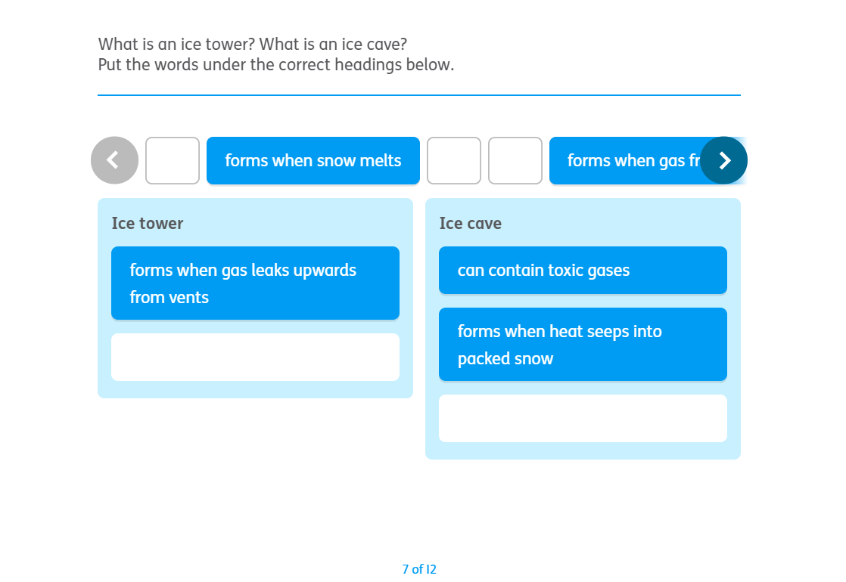
c) Quizzes
Every Coaching eBook (and all other eBooks) end with a quiz
Quizzes assess students’ understanding
Students are encouraged to check their work, and can view the marking after submission
Results feed back to the teacher and drive automatic progression
.
1
Coaching eBooks

Slide 12
2
eBook library in a nutshell
Hundreds of reliably levelled eBooks (including decodable readers) from Oxford’s favourite series for practice and consolidation. They are automatically fed to students by level. They don’t contain the coaching buddy but do contain quizzes and helpful eBook features.

Slide 13
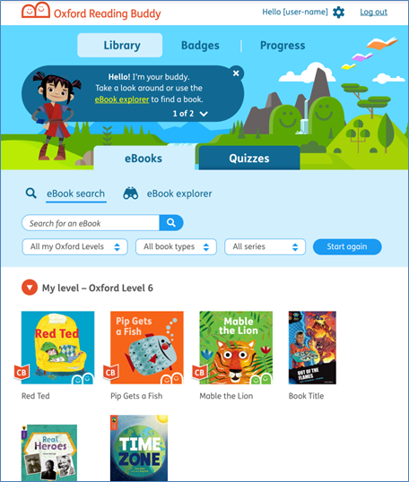
eBook library
Wide variety and choice across Oxford’s favourite series
Mobile-friendly eBooks to widen access at home
Students have access to books at their Oxford Level and below
Quizzes monitor reading volume and assess understanding
2
eBook library

Slide 14
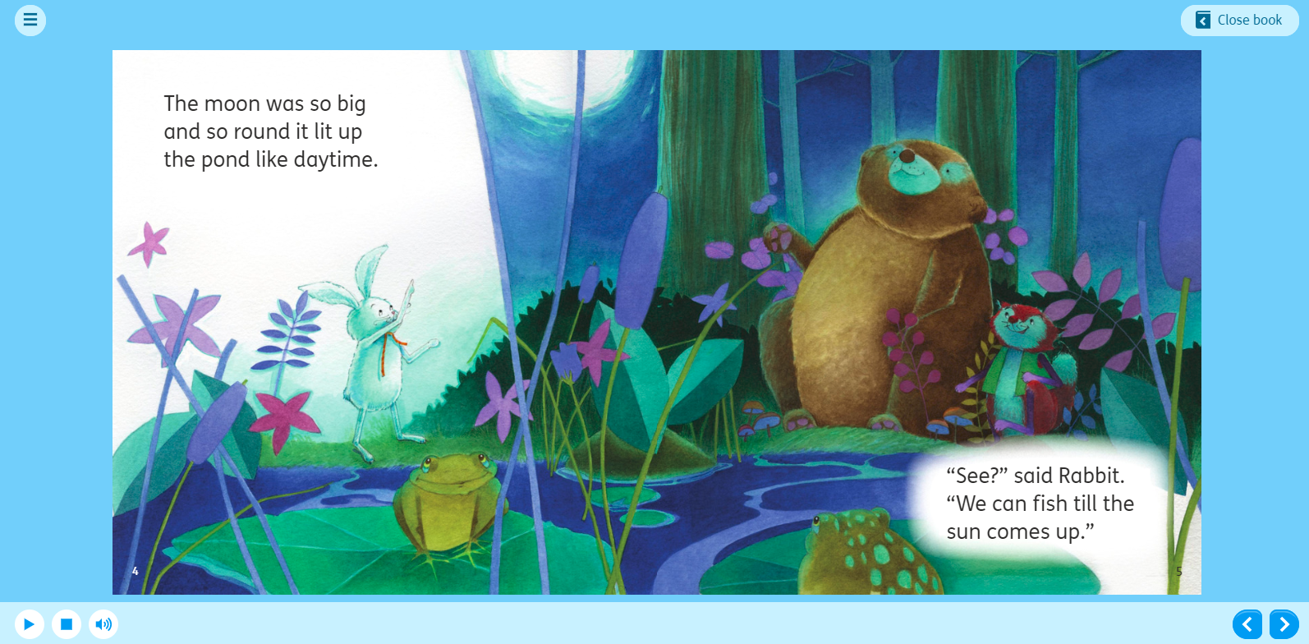
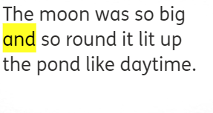
eBook features
Audio up to Oxford Level 10
Text tracking up to Oxford Level 5
2
eBook library

Slide 15
3
Quizzes in a nutshell
Hundreds of comprehension quizzes on all the eBooks in the system and print books you may already have in your classroom. Quiz-scores drive automatic progression and provide performance-feedback so that teachers can track comprehension-skill progress.

Slide 16
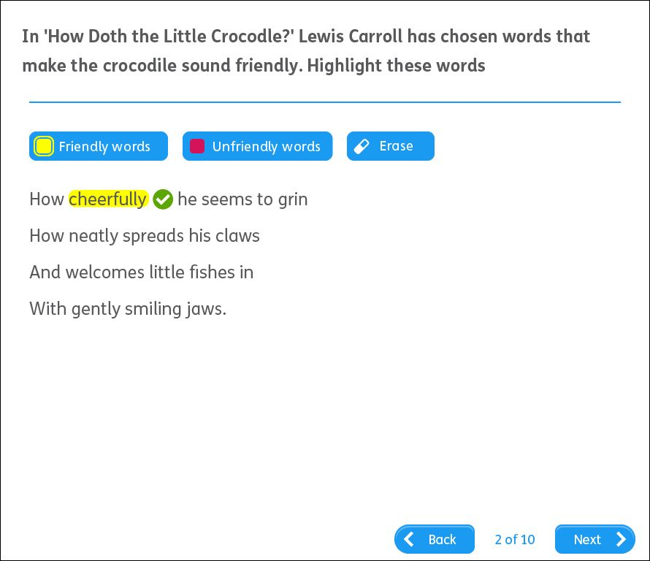
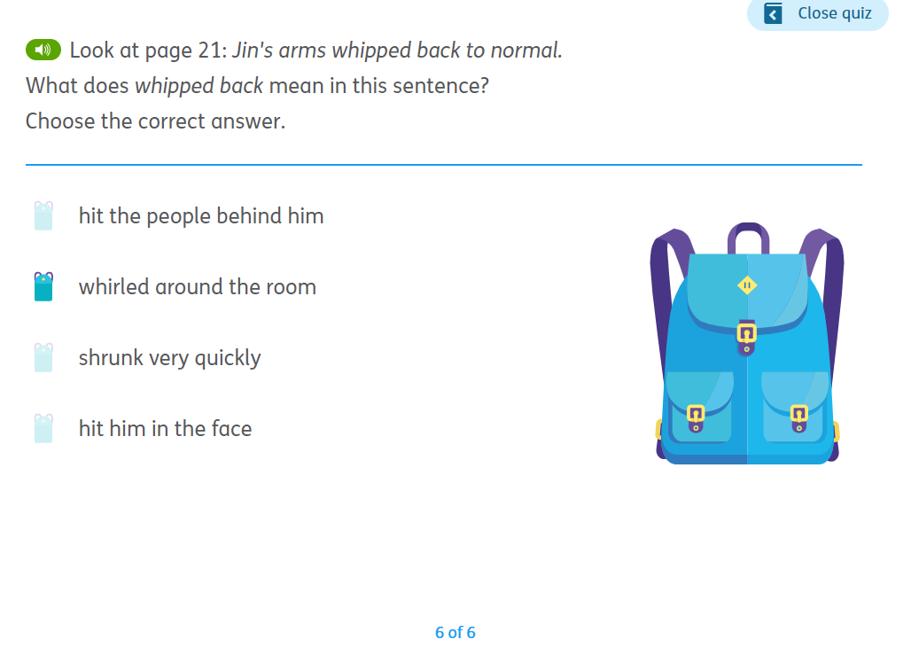
Quiz overview
Available for every book in the system plus a growing number of Oxford’s print books
Based on a Comprehension Skills framework, devised by Professors Jane Oakhill and Kate Cain
Carefully written to focus on important comprehension skills
Automatically marked, with reporting by performance and individual skill
Work on mobile devices
Quiz images
3
Quizzes

Slide 17
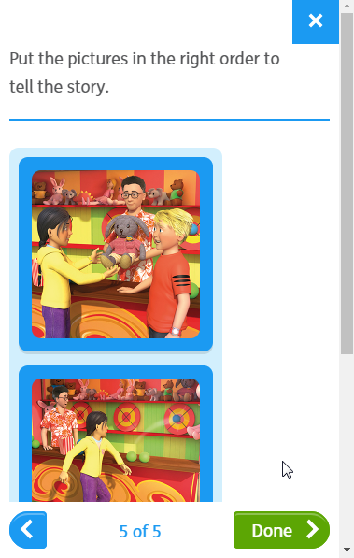
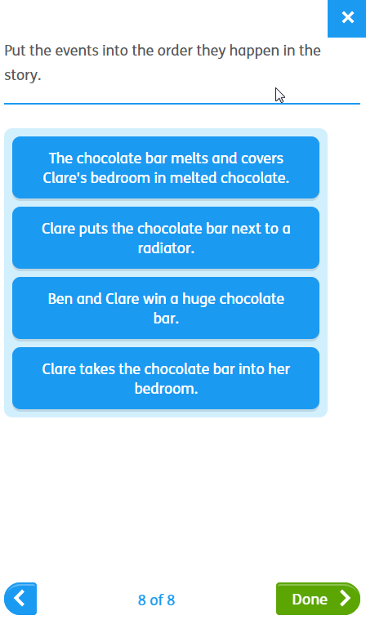
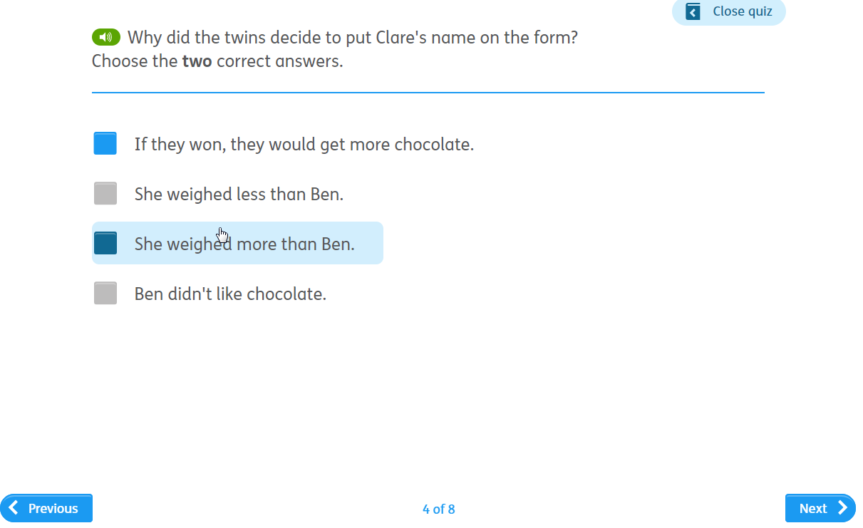
Quiz features
A wide variety of question styles to keep students engaged
Language mirrors SATs-style questions
Finely levelled to ensure appropriate level of challenge
Audio for Oxford Levels 1-10 so that higher-order comprehension skills are not limited by decoding level
3
Quizzes

Slide 18
4
Automatic placement and progress in a nutshell
Oxford Reading Buddy automatically places students on an appropriate Oxford Level based on year group and current term. It then automatically moves them through the levels based on when they meet quiz-score thresholds.

Slide 19

Automatic placement
When a student is enrolled they will automatically be assigned a default Oxford Level, based on their school year, the current term and Age Related Expectations.
Example: a Year 2 class being enrolled in Term 2 will be assigned Oxford Level 8.
Teachers can then move any outlying students manually, or wait for the system to move them automatically based on their performance.
4
Automatic placement and progress

Slide 20

Automatic progress
Students are automatically moved onto the next Oxford Level when they have met the required thresholds.
The current percentage threshold is 80% and the number of quizzes that need to be scored before move up occurs varies between Oxford Levels.
Teachers are alerted when students have met the thresholds to move level and they can approve, delay or ignore the recommendation (in the event of no response the student will be moved automatically in 2 weeks).
Students can also move down based on sustained poor performance in quizzes.
4
Automatic placement and progress

Slide 21
Automatic placement and progress: benefits
Quicker to enroll students at the start
Teachers don’t need to assign books
No child left waiting for books
Saves you time
4
Automatic placement and progress

Slide 22
5
Performance reporting in a nutshell
The reporting area shows performance against attainment, progress and engagement. There are top-level class views and school views, plus detailed views for individual students.
For step by step videos of the reporting area go to [direct link to be embedded]

Slide 23
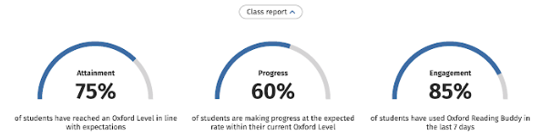
Performance reporting
Attainment shows the % of student whose Oxford Level matches or exceeds the expectation for their year group at current point in school year
Progress shows the % of students moving through their current level at the expected rate (based on quiz scores above 80% and time at level).
Engagement shows the % of students who have logged in at least once in the past 7 days
5
Performance reporting

Slide 24
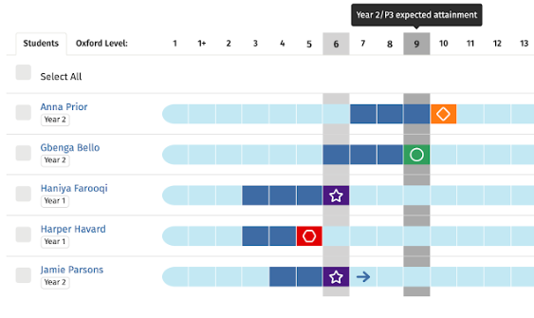
Class report: student dashboard
Blue boxes = previous Oxford Levels
Grey bar = Expected Oxford Level for ARE
Coloured box = current level and RAG colours indicate progress rate within level
Blue arrow = ready to move up
5
Performance reporting

Slide 25
Student dashboard: example
Anna Prior is at Oxford Level 10, above expected attainment, but progressing more slowly than expected at this level.
Gbenga Bello is at Oxford Level 9, the expected Oxford Level and making progress at the expected rate.
Jamie Parsons is well below his Y2 attainment expectation but making faster than expected progress within his current level. He has met the threshold to move up.
5
Performance reporting

Slide 26
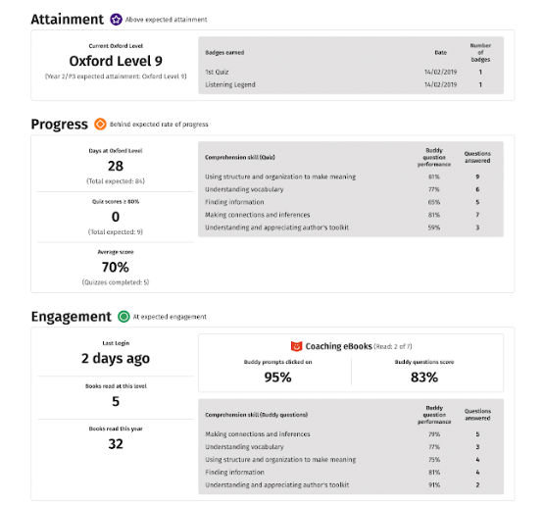
Student report: overview
Badges earned with dates
Shows individual student detail
Performance against specific comprehension skills
Quiz performance across books at current level
Engagement with Coaching eBooks

Slide 27
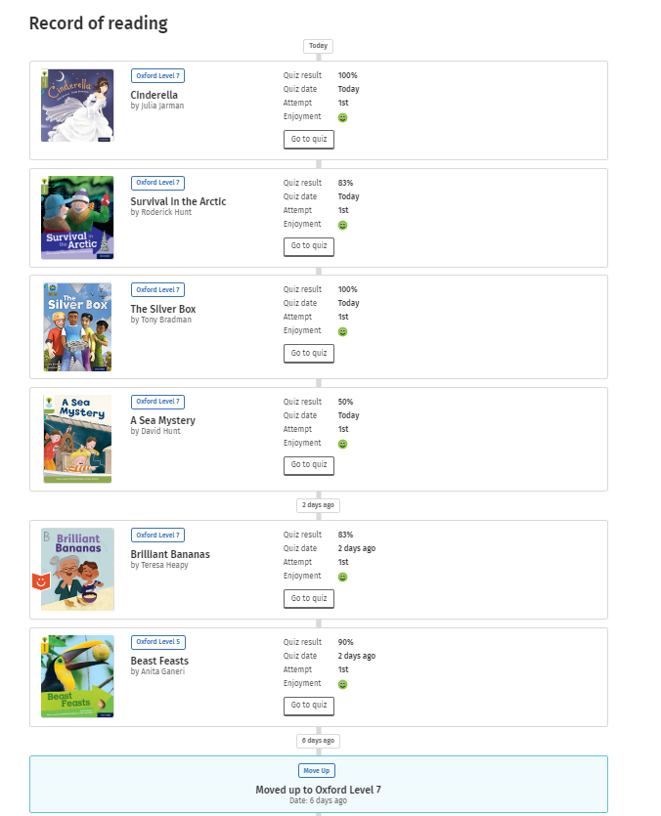
Student report: record of reading
Quiz score per book, date, enjoyment rating
Shows all books read
Links to view quiz questions (including free text answers)
Includes books read outside the system
Record of Oxford Level changes
5
Performance reporting

Slide 28
6
Reward and motivation in a nutshell
Motivation feeds into all aspects of the service, including choice of books, quiz design, feedback and Buddies. Students also earn badges for demonstrating good reading behaviours.

Slide 29
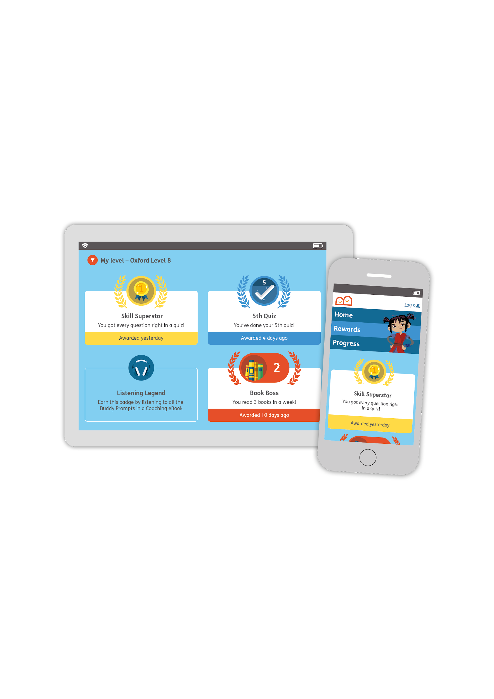
Badges
Students earn badges for reading behaviours that research shows contribute to progress, including enthusiasm, attention, stamina, good comprehension etc.
Badges are tailored to different Oxford Levels as appropriate to developmental stage
Students can see what badges they have earned, or could earn, on their Badge screen.
5
Reward and motivation

Slide 30
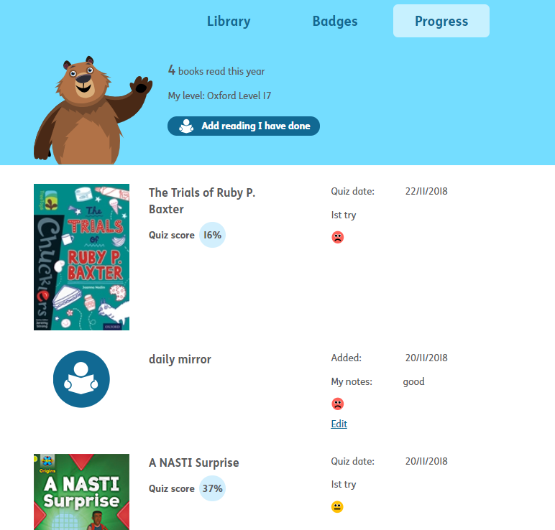
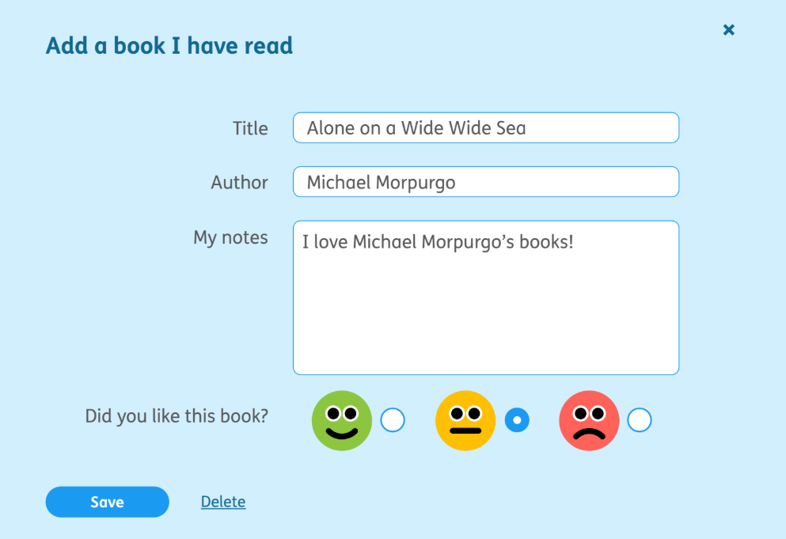
Progress screen
The Progress screen charts all the books on which students have completed quizzes
Students can also log wider reading so that their record celebrates all reading
5
Reward and motivation

Slide 31
Support site

Slide 32
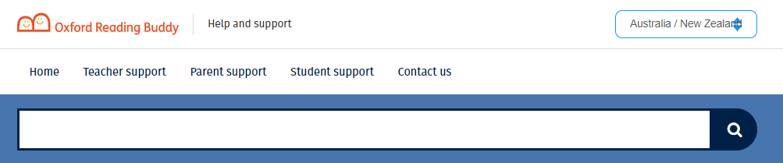
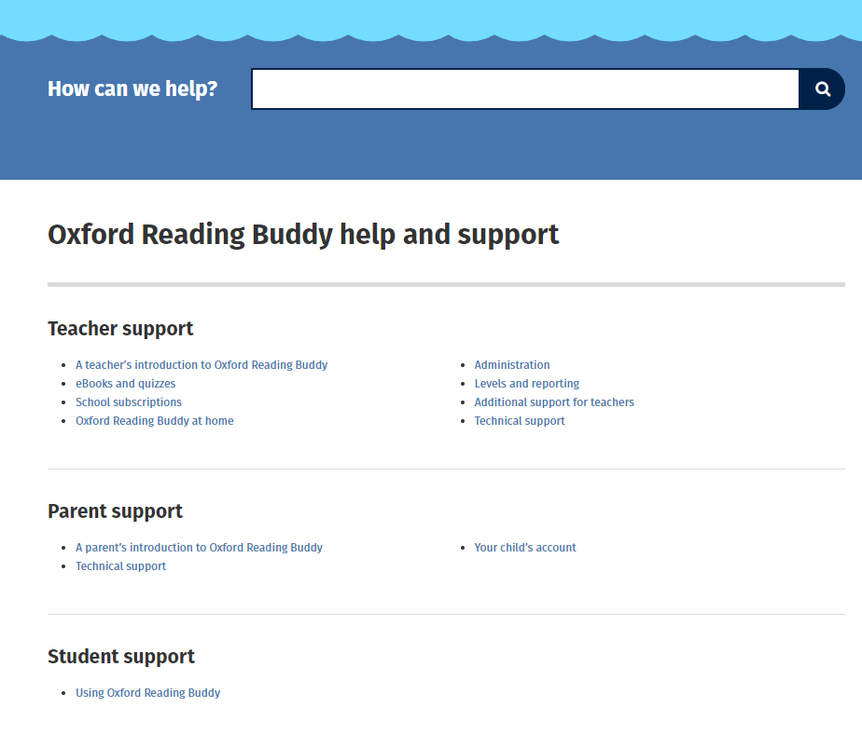
Support site
https://support.oxfordreadingbuddy.com/au/
The Support site provides comprehensive help and information about Oxford Reading Buddy.
IMPORTANT: make sure that you are viewing the Australia / New Zealand area
You can click straight to it from the service by selecting the ‘Help’ button in the top right of the screen.
As well as support for teachers there are also Parent and Student sections.
The Support site is also the home of other useful resources such as ‘how to’ videos, slide decks for parent and student launches, etc.

Slide 33
Impact study

Slide 34
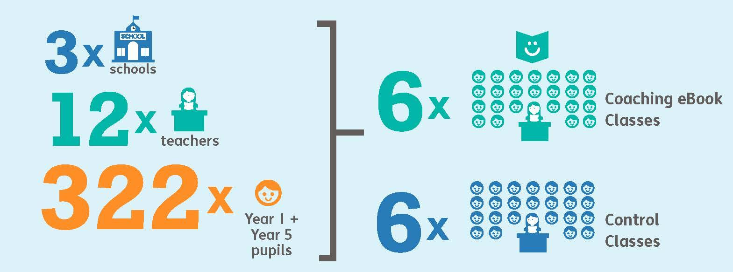
Impact study
An independent research study was commissioned to find out the benefits and challenges of using prototype (early trial version) Coaching eBooks in order to inform the pre-publication development of this aspect of the Oxford Reading Buddy service.

Slide 35
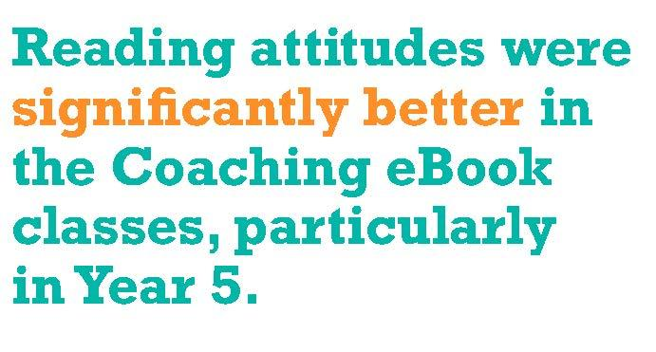
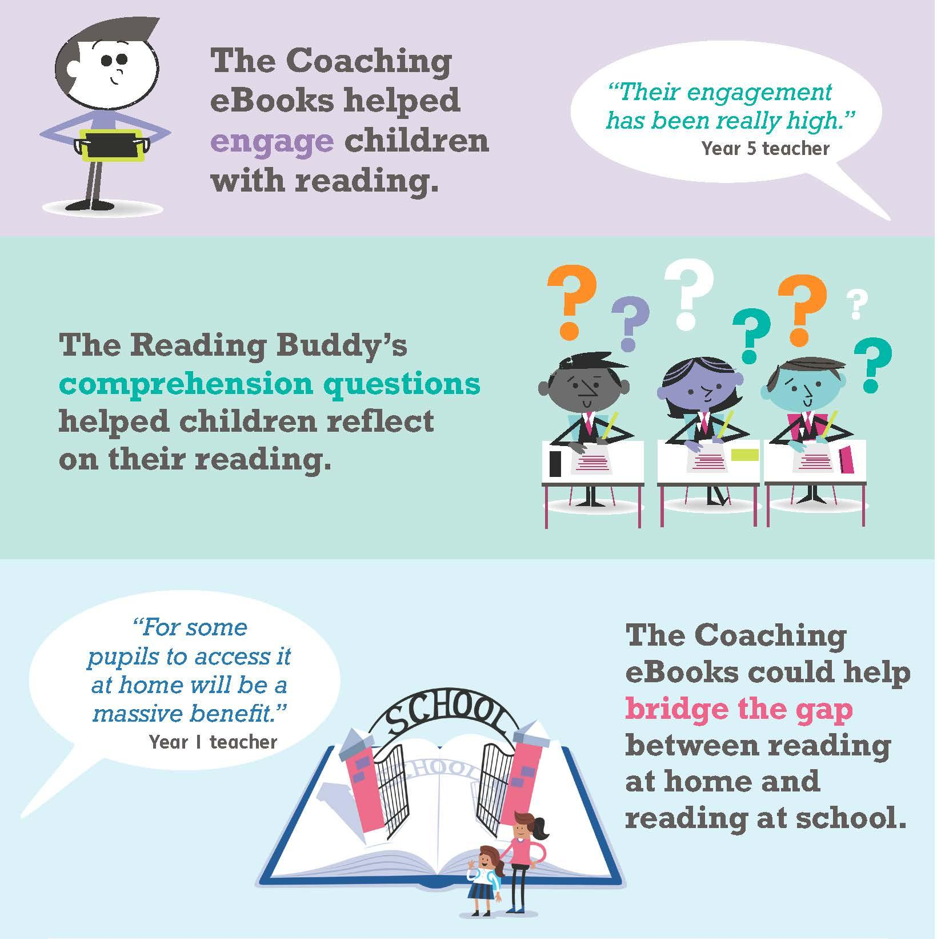
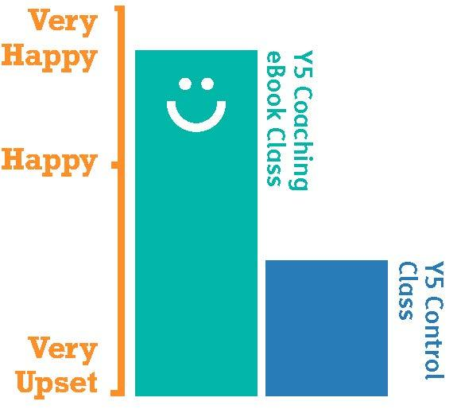
Teachers felt that...
To find out more, including challenges found and impact on final product, visit
https://www.oup.com.au/primary/oxford-reading-buddy/oxford-reading-buddy-impact-study

Slide 36
Links to additional support

Slide 37
Links to additional support
First Steps on the service | https://support.oxfordreadingbuddy.com/au/teacher-support/teachers-introduction-to-oxford-reading-buddy/your-first-steps
Reporting screen explanatory videos | https://support.oxfordreadingbuddy.com/au/teacher-support/reporting-area/
What are Oxford Levels and information about how they correlate to other levelling systems | https://www.oup.com.au/primary/oxford-levels And https://support.oxfordreadingbuddy.com/au/teacher-support/placement-guidance-for-oxford-levels/
Comprehension Skills and Strategies | https://support.oxfordreadingbuddy.com/teacher-support/skills-and-strategies-in-oxford-reading-buddy/
Parent support Including a letter to parents and newsletter article | https://support.oxfordreadingbuddy.com/au/parent-support/
Student support | https://support.oxfordreadingbuddy.com/au/student-support/
Impact study information | https://global.oup.com/education/content/primary/series/oxford-reading-buddy/impact/?region=uk

